Slide 1
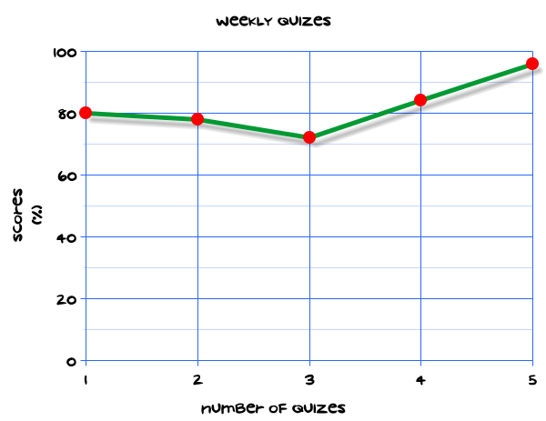
My Statistics Interactive Notebook
Name
Class
Teacher
Term 1 Semester 1
1

Slide 2
Create your own front page
It needs to contain the following –
My number interactive notebook
Name
Class
Teachers Name
Semester 1 Term 1
Page number 1

Slide 3
Contents
Glossary or Formula Page
Page
Date
Description
2
3

Slide 4
Tasks
24
7
30
Essential Question
Questions
Notes
Summary
4
5

Slide 5
24
7
30
Date
Title
EQ –
5

Slide 6
24
7
30
Date
Measures of Centre and Spread for a Data Set
EQ – Describe the differences between the different types of averages.
5

Slide 7
24
7
30
Date
Measures of Centre and Spread for a Data Set
EQ – Describe the differences between the different types of averages.
What is a measure of centre?
5

Slide 8
24
7
30
Date
Measures of Centre and Spread for a Data Set
EQ – Describe the differences between the different types of averages.
What is a measure of centre?
This finds the average value for a group of data
5

Slide 9
24
7
30
Date
Measures of Centre and Spread for a Data Set
EQ – Describe the differences between the different types of averages.
What is a measure of centre?
This finds the average value for a group of data
What are the averages?
5

Slide 10
24
7
30
Date
Measures of Centre and Spread for a Data Set
EQ – Describe the differences between the different types of averages.
What is a measure of centre?
This finds the average value for a group of data
What are the averages?
Mean , Median Mode
5

Slide 11
24
7
30
Date
Measures of Centre and Spread for a Data Set
EQ – Describe the differences between the different types of averages.
What is a measure of centre?
This finds the average value for a group of data
What are the averages?
Mean , Median Mode
How do I find the mean?
5

Slide 12

24
7
30
Date
Measures of Centre and Spread for a Data Set
EQ – Describe the differences between the different types of averages.
What is a measure of centre?
This finds the average value for a group of data
What are the averages?
Mean , Median Mode
How do I find the mean?
$$\overline{x}=\frac{\sum{x}}{n}=\frac{\text{Sum} \text{of} \text{the} \text{values}}{\text{number} \text{of} \text{values} }$$
5

Slide 13
24
7
30
Date
Measures of Centre and Spread for a Data Set
EQ – Describe the differences between the different types of averages.
What is a measure of centre?
This finds the average value for a group of data
What are the averages?
Mean , Median Mode
How do I find the mean?
$$\overline{x}=\frac{\sum{x}}{n}=\frac{\text{Sum} \text{of} \text{the} \text{values}}{\text{number} \text{of} \text{values} }$$
5

Slide 14

24
7
30
Date
Measures of Centre and Spread for a Data Set
EQ – Describe the differences between the different types of averages.
What is a measure of centre?
This finds the average value for a group of data
What are the averages?
Mean , Median Mode
How do I find the mean?
$$\overline{x}=\frac{\sum{x}}{n}=\frac{\text{Sum} \text{of} \text{the} \text{values}}{\text{number} \text{of} \text{values} }$$
How do I find the median?
5

Slide 15

24
7
30
Date
Measures of Centre and Spread for a Data Set
EQ – Describe the differences between the different types of averages.
What is a measure of centre?
This finds the average value for a group of data
What are the averages?
Mean , Median Mode
How do I find the mean?
$$\overline{x}=\frac{\sum{x}}{n}=\frac{\text{Sum} \text{of} \text{the} \text{values}}{\text{number} \text{of} \text{values} }$$
How do I find the median?
Put the values I order. Find the middle value.
If there are two middle values add together and divide by two
5

Slide 16
24
7
30
Date
Measures of Centre and Spread for a Data Set
EQ – Describe the differences between the different types of averages.
What is a measure of centre?
This finds the average value for a group of data
What are the averages?
Mean , Median Mode
How do I find the mean?
$$\overline{x}=\frac{\sum{x}}{n}=\frac{\text{Sum} \text{of} \text{the} \text{values}}{\text{number} \text{of} \text{values} }$$
How do I find the median?
Put the values I order. Find the middle value.
If there are two middle values add together and divide by two
How do I find the mode?
5

Slide 17

24
7
30
Date
Measures of Centre and Spread for a Data Set
EQ – Describe the differences between the different types of averages.
What is a measure of centre?
This finds the average value for a group of data
What are the averages?
Mean , Median Mode
$$\overline{x}=\frac{\sum{x}}{n}=\frac{\text{Sum} \text{of} \text{the} \text{values}}{\text{number} \text{of} \text{values} }$$
How do I find the mean?
How do I find the median?
Put the values I order. Find the middle value.
If there are two middle values add together and divide by two
How do I find the mode?
The value that appears most often.
A data set could have 1 mode or 2 modes (bimodal) or no mode
5

Slide 18

24
7
30
Date
Measures of Centre and Spread for a Data Set
EQ – Describe the differences between the different types of averages.
How do I find the mean?
$$\overline{x}=\frac{\sum{x}}{n}=\frac{\text{Sum} \text{of} \text{the} \text{values}}{\text{number} \text{of} \text{values} }$$
How do I find the median?
Put the values I order. Find the middle value.
If there are two middle values add together and divide by two
How do I find the mode?
The value that appears most often.
A data set could have 1 mode or 2 modes (bimodal) or no mode
Example
Find the mean, median and mode for the following set of data
2 | 3 | 3 | 4 | 5 | 7
5

Slide 19

24
7
30
Date
Measures of Centre and Spread for a Data Set
EQ – Describe the differences between the different types of averages.
How do I find the mean?
Add all the values together and divide by the number of values
How do I find the median?
Put the values I order. Find the middle value.
If there are two middle values add together and divide by two
How do I find the mode?
The value that appears most often.
A data set could have 1 mode or 2 modes (bimodal) or no mode
Example
Find the mean, median and mode for the following set of data
2 | 3 | 3 | 4 | 5 | 7
$\overline{x}=\frac{2+3+3+4+5+7}{6}=\frac{24}{6}=4$
5

Slide 20

24
7
30
Date
Measures of Centre and Spread for a Data Set
EQ – Describe the differences between the different types of averages.
How do I find the mean?
Add all the values together and divide by the number of values
How do I find the median?
Put the values I order. Find the middle value.
If there are two middle values add together and divide by two
How do I find the mode?
The value that appears most often.
A data set could have 1 mode or 2 modes (bimodal) or no mode
Example
Find the mean, median and mode for the following set of data
2 | 3 | 3 | 4 | 5 | 7
$\overline{x}=\frac{2+3+3+4+5+7}{6}=\frac{24}{6}=4$
Median =
5

Slide 21
24
7
30
Date
Measures of Centre and Spread for a Data Set
EQ – Describe the differences between the different types of averages.
How do I find the mean?
Add all the values together and divide by the number of values
How do I find the median?
Put the values I order. Find the middle value.
If there are two middle values add together and divide by two
How do I find the mode?
The value that appears most often.
A data set could have 1 mode or 2 modes (bimodal) or no mode
Example
Find the mean, median and mode for the following set of data
2 | 3 | 3 | 4 | 5 | 7
$\overline{x}=\frac{2+3+3+4+5+7}{6}=\frac{24}{6}=4$
Median =
5

Slide 22

24
7
30
Date
Measures of Centre and Spread for a Data Set
EQ – Describe the differences between the different types of averages.
How do I find the mean?
Add all the values together and divide by the number of values
How do I find the median?
Put the values I order. Find the middle value.
If there are two middle values add together and divide by two
How do I find the mode?
The value that appears most often.
A data set could have 1 mode or 2 modes (bimodal) or no mode
Example
Find the mean, median and mode for the following set of data
2 | 3 | 3 | 4 | 5 | 7
$\overline{x}=\frac{2+3+3+4+5+7}{6}=\frac{24}{6}=4$
Median = $\frac{3+4}{2}=3.5$
5

Slide 23

24
7
30
Date
Measures of Centre and Spread for a Data Set
EQ – Describe the differences between the different types of averages.
How do I find the mean?
Add all the values together and divide by the number of values
How do I find the median?
Put the values I order. Find the middle value.
If there are two middle values add together and divide by two
How do I find the mode?
The value that appears most often.
A data set could have 1 mode or 2 modes (bimodal) or no mode
Example
Find the mean, median and mode for the following set of data
2 | 3 | 3 | 4 | 5 | 7
$\overline{x}=\frac{2+3+3+4+5+7}{6}=\frac{24}{6}=4$
Median = $\frac{3+4}{2}=3.5$ (halfway between 3 and 4)
5

Slide 24

24
7
30
Date
Measures of Centre and Spread for a Data Set
EQ – Describe the differences between the different types of averages.
How do I find the mean?
Add all the values together and divide by the number of values
How do I find the median?
Put the values I order. Find the middle value.
If there are two middle values add together and divide by two
How do I find the mode?
The value that appears most often.
A data set could have 1 mode or 2 modes (bimodal) or no mode
Example
Find the mean, median and mode for the following set of data
2 | 3 | 3 | 4 | 5 | 7
Mean =$\frac{2+3+3+4+5+7}{6}=\frac{24}{6}=4$
Median = $\frac{3+4}{2}=3.5$ (halfway between 3 and 4)
Mode is 3
5

Slide 25


24
7
30
Date
Measures of Centre and Spread for a Data Set
EQ – Describe the differences between the different types of averages.
Example
Find the mean, median and mode for the following set of data
2 | 3 | 3 | 4 | 5 | 7
Mean =$\frac{2+3+3+4+5+7}{6}=\frac{24}{6}=4$
Mode is 3
Median = $\frac{3+4}{2}=3.5$ (halfway between 3 and 4)
What are quartiles?
5

Slide 26
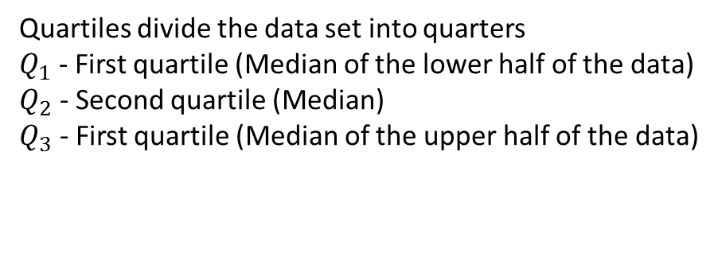
24
7
30
Date
Measures of Centre and Spread for a Data Set
EQ – Describe the differences between the different types of averages.
Example
Find the mean, median and mode for the following set of data
2 | 3 | 3 | 4 | 5 | 7
Mean =$\frac{2+3+3+4+5+7}{6}=\frac{24}{6}=4$
Mode is 3
Median = $\frac{3+4}{2}=3.5$ (halfway between 3 and 4)
What are quartiles?
Quartiles divide the data set into quarters
$Q_{1}$ - First quartile (Median of the lower half of the data)
$Q_{2}$ - Second quartile (Median)
$Q_{3}$ - First quartile (Median of the upper half of the data)
5

Slide 27
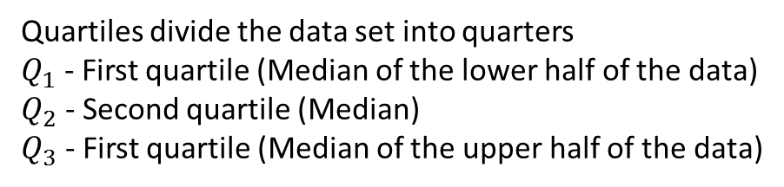
24
7
30
Date
Measures of Centre and Spread for a Data Set
EQ – Describe the differences between the different types of averages.
What are quartiles?
Quartiles divide the data set into quarters
$Q_{1}$ - First quartile (Median of the lower half of the data)
$Q_{2}$ - Second quartile (Median)
$Q_{3}$ - First quartile (Median of the upper half of the data)
Example
2 | 3 | 3 | 4 | 5 | 7
Lower half
Upper half
5

Slide 28

24
7
30
Date
Measures of Centre and Spread for a Data Set
EQ – Describe the differences between the different types of averages.
What are quartiles?
Quartiles divide the data set into quarters
$Q_{1}$ - First quartile (Median of the lower half of the data)
$Q_{2}$ - Second quartile (Median)
$Q_{3}$ - First quartile (Median of the upper half of the data)
Example
2 | 3 | 3 | 4 | 5 | 7
Lower half
Upper half
$Q_{1}$= 3
5

Slide 29

24
7
30
Date
Measures of Centre and Spread for a Data Set
EQ – Describe the differences between the different types of averages.
What are quartiles?
Quartiles divide the data set into quarters
$Q_{1}$ - First quartile (Median of the lower half of the data)
$Q_{2}$ - Second quartile (Median)
$Q_{3}$ - First quartile (Median of the upper half of the data)
Example
2 | 3 | 3 | 4 | 5 | 7
Lower half
Upper half
$Q_{1}$= 3 $Q_{2}=3.5$
5

Slide 30
24
7
30
Date
Measures of Centre and Spread for a Data Set
EQ – Describe the differences between the different types of averages.
What are quartiles?
Quartiles divide the data set into quarters
$Q_{1}$ - First quartile (Median of the lower half of the data)
$Q_{2}$ - Second quartile (Median)
$Q_{3}$ - First quartile (Median of the upper half of the data)
Example
2 | 3 | 3 | 4 | 5 | 7
Lower half
Upper half
${ Q}_{1}$= 3 $Q_{2}=3.5$ $Q_{3}$=5
5

Slide 31
24
7
30
Date
Measures of Centre and Spread for a Data Set
EQ – Describe the differences between the different types of averages.
What are quartiles?
Quartiles divide the data set into quarters
$Q_{1}$ - First quartile (Median of the lower half of the data)
$Q_{2}$ - Second quartile (Median)
$Q_{3}$ - First quartile (Median of the upper half of the data)
Example
2 | 3 | 3 | 4 | 5 | 7
Lower half
Upper half
${ Q}_{1}$= 3 $Q_{2}=3.5$ $Q_{3}$=5
What are the measures of spread?
Range = difference between the highest and lowest values
Example : 7 – 2 = 5
5

Slide 32
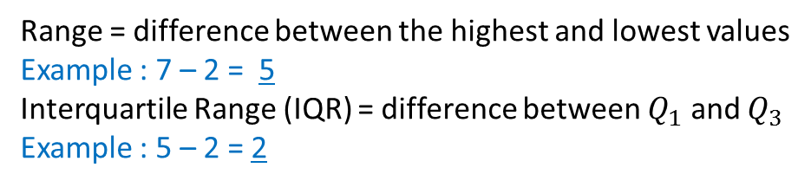
24
7
30
Date
Measures of Centre and Spread for a Data Set
EQ – Describe the differences between the different types of averages.
What are quartiles?
Quartiles divide the data set into quarters
$Q_{1}$ - First quartile (Median of the lower half of the data)
$Q_{2}$ - Second quartile (Median)
$Q_{3}$ - First quartile (Median of the upper half of the data)
Example
2 | 3 | 3 | 4 | 5 | 7
Lower half
Upper half
${ Q}_{1}$= 3 $Q_{2}=3.5$ $Q_{3}$=5
What are the measures of spread?
Range = difference between the highest and lowest values
Example : 7 – 2 = 5
Interquartile Range (IQR) = difference between $Q_{1}$ and $Q_{3}$
Example : 5 – 2 = 2
5

Slide 33
Questions

Slide 34
Notes Review
24, 7 ,30
Date
Title
Essential question
Notes complete
Notes complete with colour and diagrams
Questions completed
Contents page filed in
Formula page filled in

Slide 35
Homework
Review your notes and write a summary answering the essential question.

